Slide 1
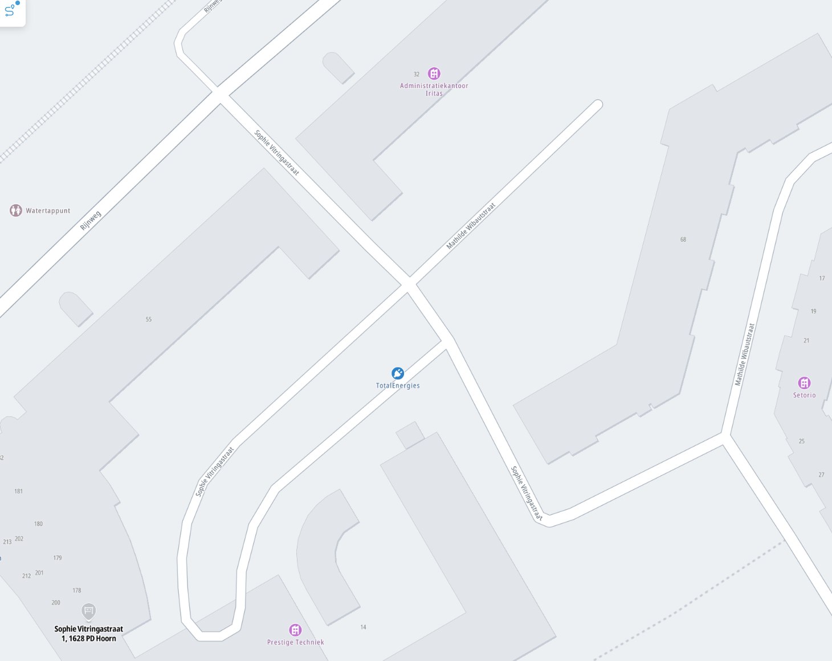
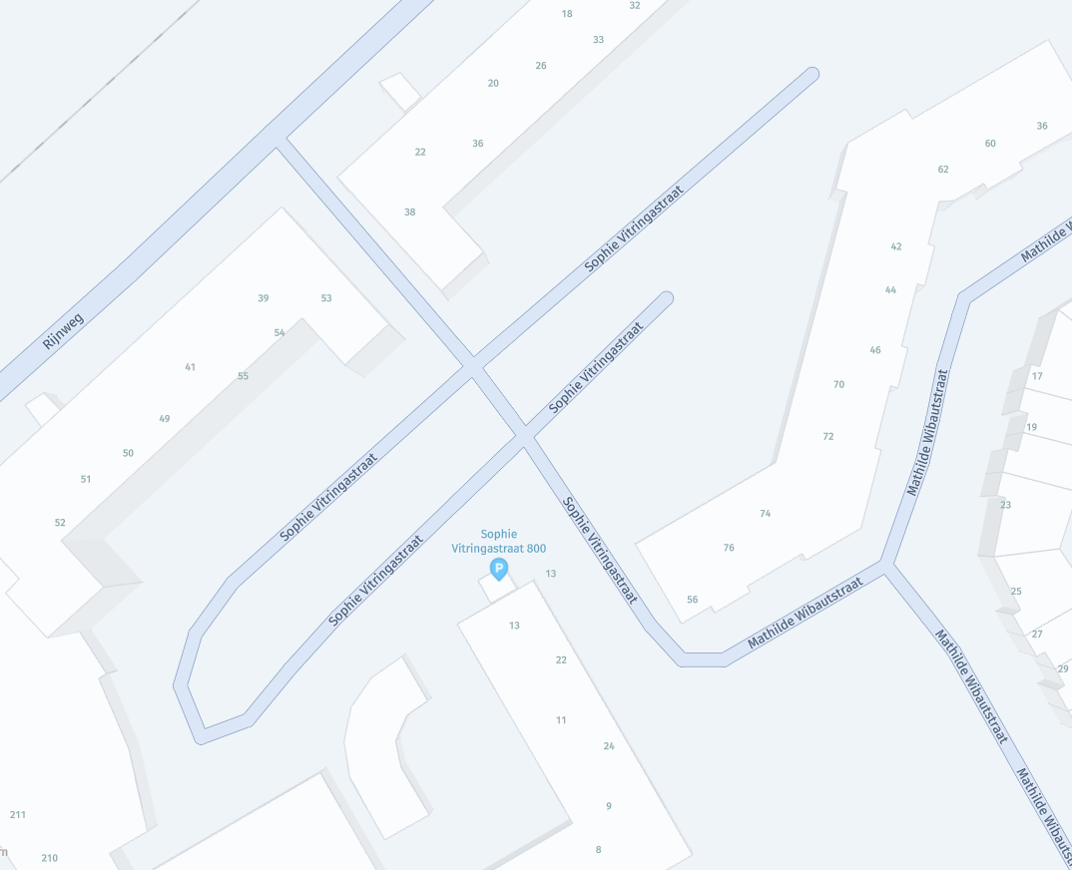
Map of vendor A
Map of vendor B

Slide 2
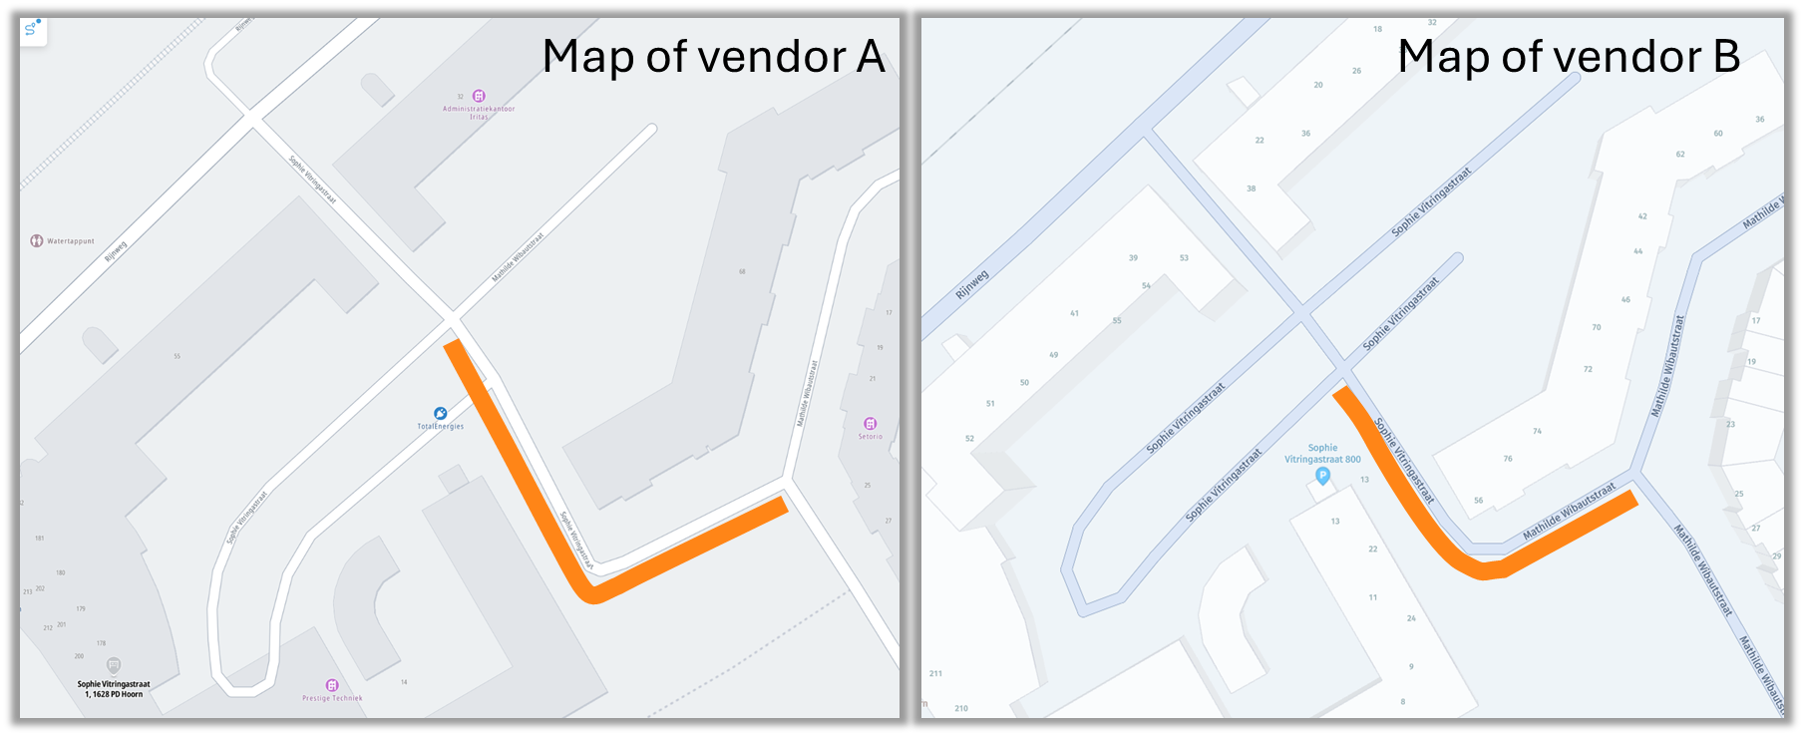

Slide 5
Notes:
https://wego.here.com/?map=52.65337,5.0869,19.49

Slide 6
Notes:
https://plan.tomtom.com/nl?p=52.65341,5.08704,18.9z Plan.TomTom.com

